Slide 1
ABAP Lock Concept
Adrian Streitz, Johannes Rank, Borys Levkovskyi

Slide 2
Prerequisites
Experience with ABAP Workbench and Eclipse
Basic ABAP programming skills
Experience with database access within ABAP programs

Slide 3
Agenda
Introduction
Data consistency
Lock object types
Lock usage
Creation process
Enqueue/dequeue functions
Monitoring

Slide 4


I. Introduction Operational concurrency
Using SAP applications we access shared data resources from the database
Consistent data if we only perform
READ operations
READ and WRITE operations in sequence
Data inconsistency: concurrent WRITE operations using same dataset
Solution: lock concept to facilitate operational concurrency and data consistency together
ID | name | amount
1 | Joe | 100
2 | Frank | 110
3 | Sue | 100
1 | Joe | 120
1 | Joe | 85

Slide 5
I. Introduction General information
What happens when several users want to work on the same data set? → data inconsistency
Lock objects (SAP dictionary structure) prevent simultaneous changes on data set
Beside the lock concept of the database, SAP implements its own lock concept
SAP does not use the database’s lock concept

Slide 6


II. Data consistency Trigger for database commits and rollbacks
Implicit database commits
Completion of a dialog step
Transmission of error, warning and information messages
Call of an remote function module
Program interruption with instruction WAIT
Implicit database rollbacks
Occurrence of a runtime error
Transmission of a termination or exit message

Slide 7
II. Data consistency SAP LUW (Logical Unit of Work)
Start
Roll-out/
Roll-in
Roll-out/
Roll-in
Program section
Program section
Program section
Work process
Work process
Work process
SAP-LUW
DB-LUWs

Slide 8
II. Data consistency SAP LUW (Logical Unit of Work)
Problem
New data sets are transferred into the database by each screen
Only if last screen of the program is reached and all data sets are written to the database the data are correct
Solution
Updates to database are written to the updater process
Only when last screen of the program is reached, the updater receives a trigger to write data to database (commit) or to dismiss (rollback)
→ ensures data integrity

Slide 9
II. Data consistency The updater process
Schema:
Protocol table
Data
Data
Data
Data
Data
deletes
3
1
5
Work process
Work process
2
Updater
Program
4
→ Lock data set
Database

Slide 10
II. Data consistency Using the updater process
Function Modules
CALL FUNCTION … IN UPDATE TASK.
SAP LUW termination
COMMIT WORK [AND WAIT].
ROLLBACK WORK.
Registration of subroutines
PERFORM … ON COMMIT | ROLLBACK.

Slide 11
II. Data consistency SAP lock concept
Ensure concurrent database access from several SAP applications by guaranteeing data consistency at the same time
SAP locks are independent from database locks
SAP locks are claimed till the end of an SAP LUW
No physical locks on database, but entries in specific SAP table which contains all SAP locks
Specific SAP lock objects are required to make use of the SAP lock concept
Lock objects have to start with the letter E (e.g. EZ_DEMOTABLE)

Slide 12
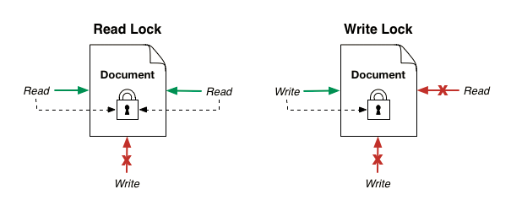
III. Lock object types Shared vs. exclusive lock
Read lock = shared lock
Locks data set for reading
Multiple shared locks on one data set at the same time possible
Prevents the SAP system from creating an exclusive lock on a data set
Write lock = exclusive lock
Locks data set for writing/changing
No shared locks, only one is allowed at the same time
First come, first serve

Slide 13
IV. Lock usage Enqueue and dequeue lock objects
Two function modules are generated automatically when creating a lock object:
Before writing/reading data set → lock data set
After writing/reading data set → unlock data set
In case of an error → unlock data set
Locks can be displayed and deleted in transaction SM12 (SAP GUI)
lock data set
Enqueue_<lock object>
unlock data set
Dequeue_<lock object>

Slide 14
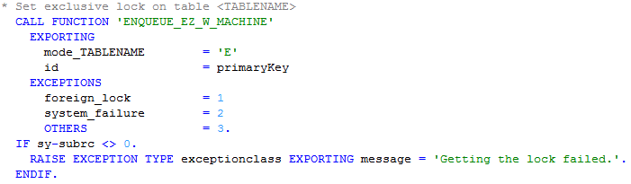
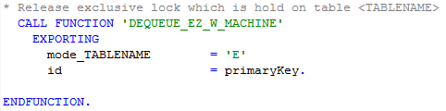
IV. Lock usage Acquire and Release
ACQUIRE new lock object
RELEASE existing lock object

Slide 15
IV. Lock usage Selection of enqueue parameters
Parameter | Value | Meaning
mode_<tabname> | ‘S‘ ‘E‘ | Read lock (shared) Exclusive lock (not shared)
<lock parameter> | <value> | Field values used to lock the data set
_wait | SPACE ‘X‘ | If foreign lock, no new attempt If foreign lock, new attempt
_collect | SPACE ‘X‘ | Lock without local lock container Lock with local lock container

Slide 16
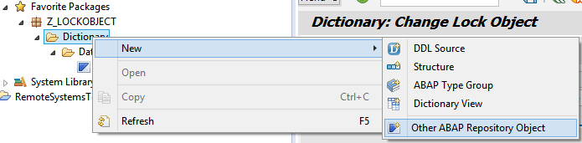
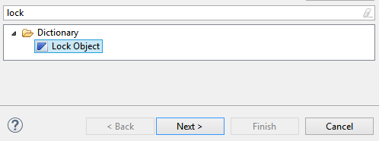
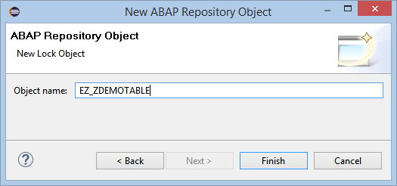
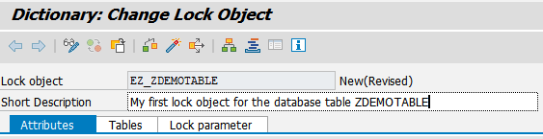
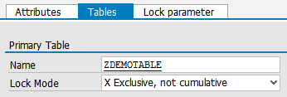
V. Creation process Create first lock object
Prerequisites: existing database table
Right-click on Dictionary → New → Other ABAP Repository Object
Choose entry “Lock Object” → Next → Define name (stick to the SAP and course conventions!) → Finish
Fill in Description
Tables tab: reference to the database table you want to create this lock object for → Save (choose the same package as the table is located in and create a new transport request) → Activate

Slide 17
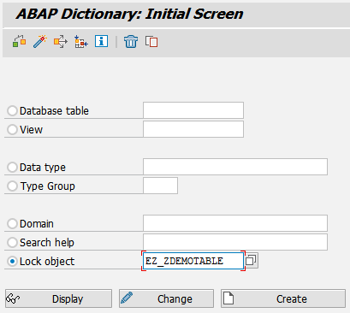
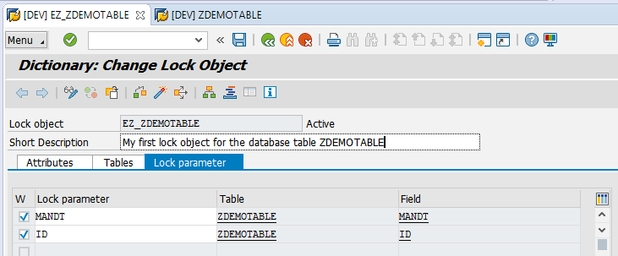
V. Creation process Create first lock object
Creation can also be done in data dictionary (SE11)
There is only one lock object per database table which handles all type of locks (shared and exclusive)
Lock objects are generated automatically by using the primary key
ENQUEUE_<Lock_Object>
DEQUEUE_<Lock_Object>

Slide 18
VI. Enqueue/dequeue functions Automatic generation
Lock object
EZ_ZDEMOTABLE
Activate
Function
Function
ENQUEUE_EZ_ZDEMOTABLE
DEQUEUE_EZ_ZDEMOTABLE
→ Lock data set
→ Unlock data set

Slide 19
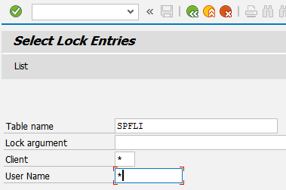
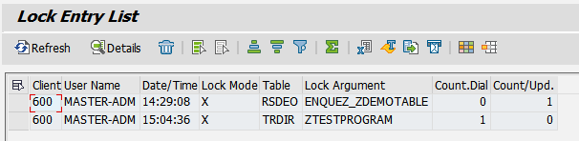
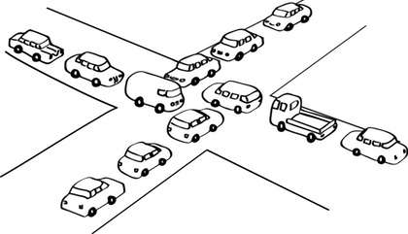

VII. Monitoring Display and deletion of current locks
Monitoring current locks is only available by using the SAP GUI
Transaction SM12 enables you to search for current locks and to delete them
Please keep in mind to avoid deadlocks situations by acquiring dependent locks

Slide 20
Now you know how to apply SAP locks for your program.
To consolidate your knowledge, you can do task 1 and 2 of the Lock Concept exercise.

Slide 21
Check your knowledge

Slide 22
Check your knowledge
Data inconsistency arises from concurrent operational access on the same dataset.
□ True □ False
Enqueue and dequeue functions are generated automatically by creating the corresponding SAP lock object.
□ True □ False
Explain the difference between database and SAP locks. What are their main objectives?
Which of the following message types is implicitly used to perform a database commit?
□ EXIT □ ERROR □ TERMINATION □ WARNING □ INFORMATION

Slide 23
Solution

Slide 24
Solution
Data inconsistency arises from concurrent operational access on the same dataset.
□ True ☒ False
Enqueue and dequeue functions are generated automatically by creating the corresponding SAP lock object.
☒ True □ False
Explain the difference between database and SAP locks. What are their main objectives?
See section Data Consistency
Which of the following message types is implicitly used to perform a database commit?
□ EXIT ☒ ERROR □ TERMINATION ☒ WARNING ☒ INFORMATION

Slide 25
References
Schwaiger, R. (2016): Schrödinger programmiert ABAP: Das etwas andere Fachbuch, SAP PRESS, 2016
Keller, H.; Krüger, S. (2006): ABAP Objects: ABAP-Programmierung mit SAP NetWeaver, Rheinwerk Publishing

